Slide 1

When Business Process & Incident Response Collide
The Fine Tuning of the Incident Response Program
Reneaué Railton
Sr. Information Security Analyst,
Duke Medicine Cyber Defense & Response
Notes:
A business process is an activity or set of activities that will accomplish a specific organizational goal. We all have them, but when it comes to securing our enterprise, even carefully laid plans can go awry. In Incident Response, we often have to think outside the box to deliver an effective solution.

Slide 2

Incident Response
What is the most importance component of an Incident Response Program?
Tools? Processes?
Governance? Policy?
Experience?
Notes:
The answer depends on who you ask.
There is a delicate balance between proactive and reactive processes. Many organization believe prevention is the key, and the emphasis is put on risk assessment, compliance and policy. But there isn’t a perfect preventive solution. Our networks are under attack, often through previously unknown exploits (zero-days) or techniques. The same considerations must be given to support investments in reactive technologies – threat detection & tools, incident response resources & training, etc.

Slide 3
Risks to the Organization
Poor user practices (phishing and insecure data storage)
Inconsistent security practices (adherence to policy ie., exceptions, patching)
Failure to detect attacks (ineffective tools, lack of experience)
Sprawl and amount of data (mobile, remote users, cloud services)
Notes:
What are the some of the problems the organization faces?
Security Awareness/Users
Training for IT staff
Lack of tools/resources
Too much data
changing landscape
Agility; JIT solutions
Failure to comply with Policies

Slide 4
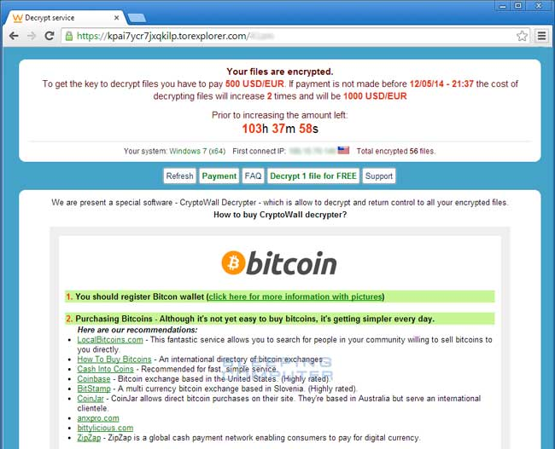
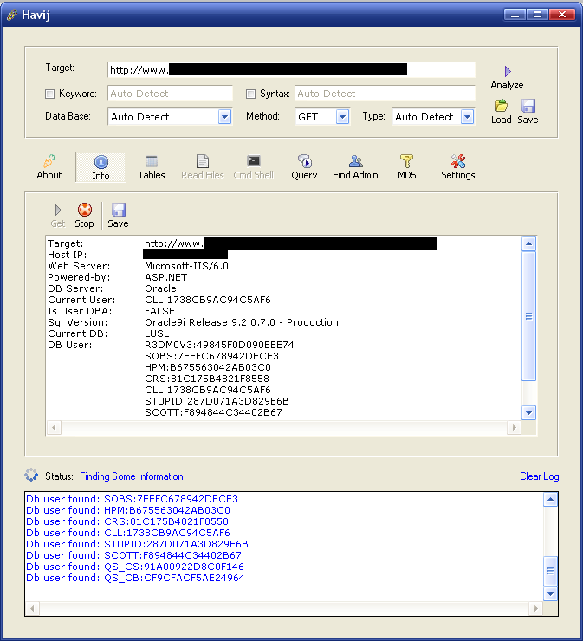
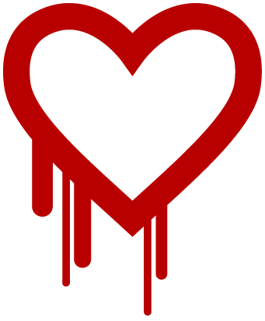
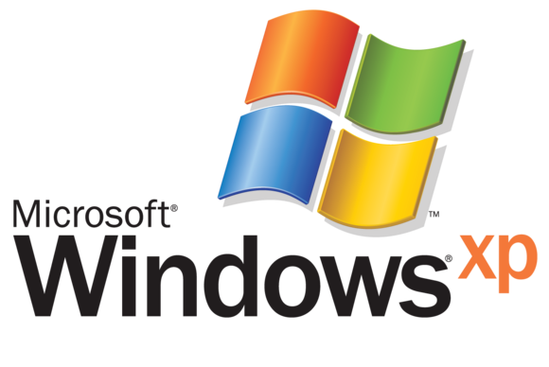
Risks lead to Incidents…

Slide 5

We’re loosing visibility!
Our attack surface is increasing!
My controls aren’t working!!
A Breach is imminent!
Notes:
The attack surface is Increasing with the addition of BYOD, Cloud services
Visibility is becoming more difficult
With decreasing visibility comes a decreased ability to apply controls
Fewer controls on a greater attack surface creates a higher risk of breach.
Breaches were a news staple in 2014, and 2015 kicked off with news of breaches in healthcare organizations that exposed close to 13.5 million Record.

Slide 6
World’s Largest Data Breaches
Breach by data sensitivity
Breach by number of records stolen
http://www.informationisbeautiful.net/visualizations/worlds-biggest-data-breaches-hacks/
Notes:
Duke Medicine is most concerned with Data Breaches. While credit card data is commonly
targeted and remains in demand, it is highly perishable—with a shelf life generally of a few
days to a week before the illicit activity is detected and the cards disabled. Theft of
medical records, however, is often not immediately identified by patients or their
providers, giving cybercriminals sometimes years to use such data, making medical data
more valuable than credit card data. Cybercriminals commonly target medical records for
patients’ names, birth dates, policy numbers, diagnosis codes, and billing information.
While CC #’s may be only worth a few cents to a dollar on criminal forums, Medical records go for up to $10/record.

Slide 7
Ponemon 2015 Benchmark Study on Privacy & Security of Healthcare Data
90% of Healthcare organizations in the study experienced a breach
40% had 5 or more data breaches over 2 years
Estimated average cost of healthcare breach over $2.1 million
Criminal attacks are the #1 cause of data breaches in Healthcare
Attacks are up 125% compared to 5 years ago
Notes:
If you want an exciting job in Incident Response and exposure to all the latest advanced threats, Healthcare is where it’s at!!!

Slide 8
Threats
What can we do?
We’re under attack right now!
Attackers are winning!
It’s getting worse!
Notes:
All networks are being scanned for services and vulnerabilities, all the time (“background radiation”).
Brute force attacks, web vulnerabilities in widely deployed CMS’, default credentials: in any large environment, there will be targets susceptible to these attacks.
Obviously there are finite resources to devote to the problem.
Attackers have increased their success by automating attacks, so we must also automate our defenses so that they run at network speed (or as close as we can get).
In addition to the usual defense-in-depth strategies (deploy at network, on endpoint, training people, etc), we *must* automate our defenses to weed out the “background radiation” of internet attacks and endpoint compromises so our resources can be concentrated on more targeted attacks.
Most of the high-profile breaches are the work of an attacker *targeting* an institution;

Slide 9


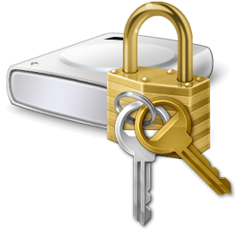
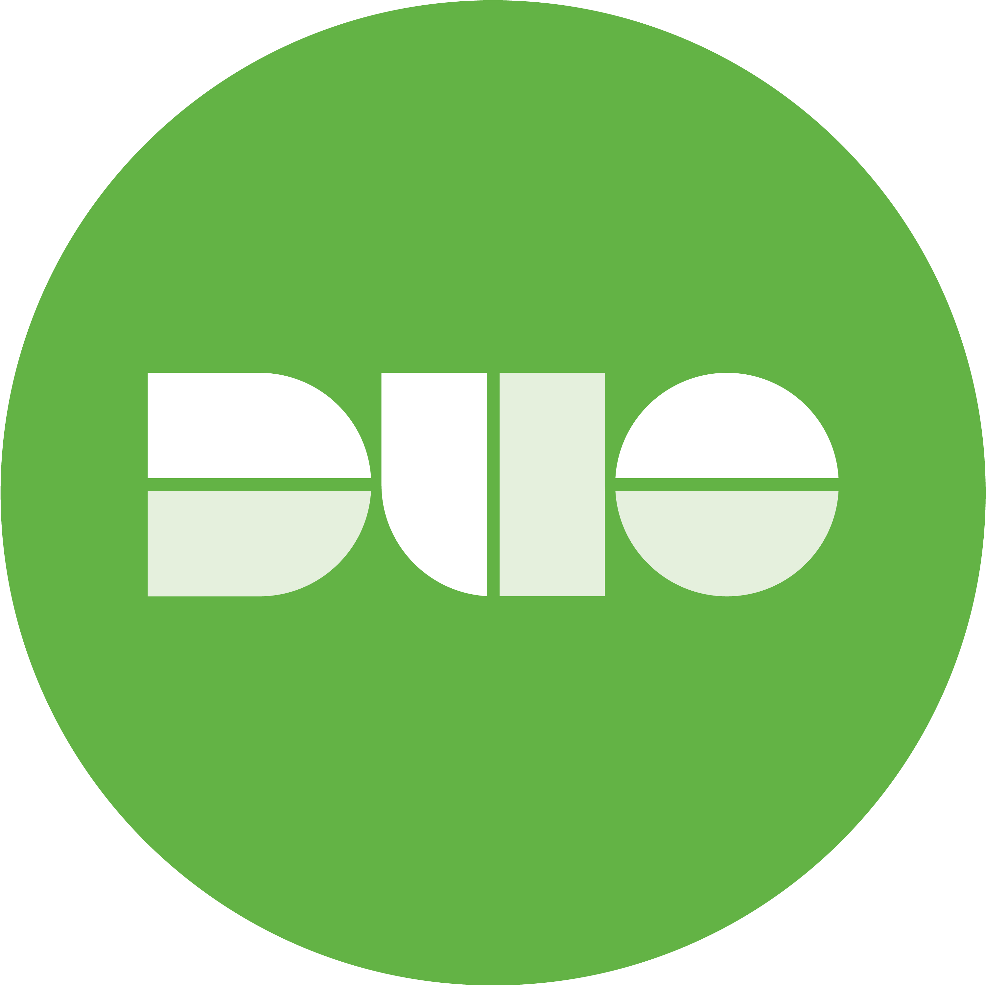







What is our current focus?
Compromised Accounts
Log Analysis with Splunk
Vulnerable Systems
Vulnerability scanning and remediation
Compromised Systems
Log analysis and network data
Sensitive Data
Data loss prevention technologies and policy

Slide 10
Scaling the Response?
Incident Response Program needs to be 24/7
Automation only works on “known quantities”
How do we make the argument for better tools or more resources?
Notes:
We heavily use Splunk as both a central log store for all our detection engines (Firewall, IDS, Symantec, host logs, etc) as well as a correlation engine. We can generate “reports” based on specific criteria, and notify us of specific activities. We can use these reports to identify compromised accounts, remote attackers, and locally compromised machines.
Reports can be automatically exported and/or have a script run on the results; currently the University uses a script that extracts attacker IP addresses and submits them to their CIF server at a high confidence value.
This allows us to detect more attacks, earlier, and protect the entire network more successfully. But with a small team that is not 24/7 it is still difficult to scale.

Slide 11




Oh No! My email account will be deleted unless I validate my account now!
I don’t see why I need MFA.
My paycheck was deposited where!?
Case Study
You’ve got Mail!
Crash!
A virus encrypted my files and I don’t have a backup!
CryptoWall ???
I guess that’s one way to get user’s to comply with data encryption policies!

Slide 12
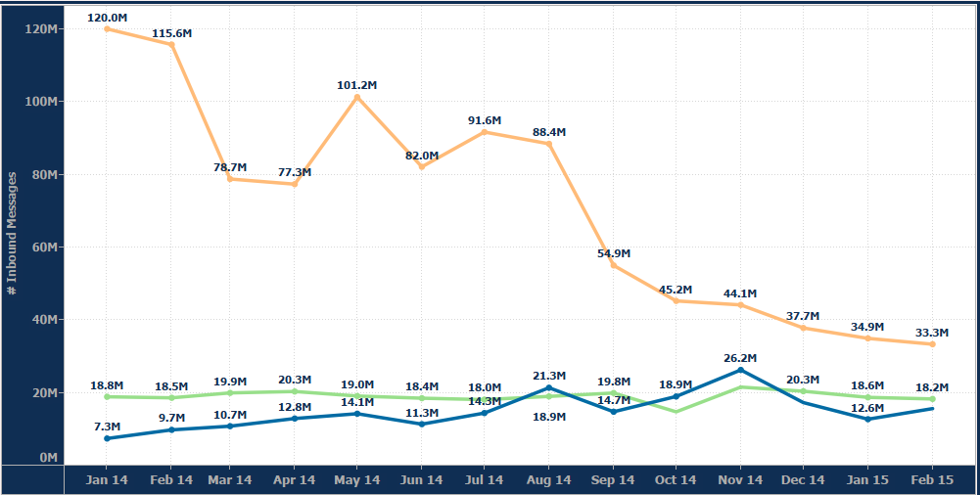
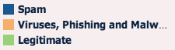
Email Attacks
Systems processed > 4.7M emails per day at peak; 4.5M malicious emails were deleted each day (>3000/minute)
Of 146M emails received in January only about 13% were legitimate (5% were spam, 82% were viruses, phishing, and other malware)

Slide 13
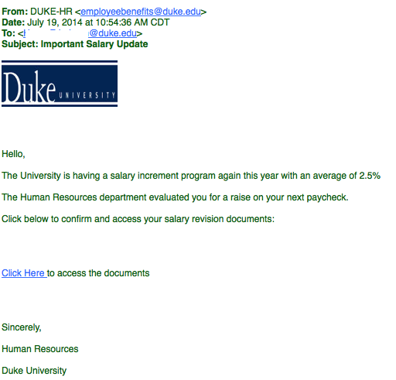
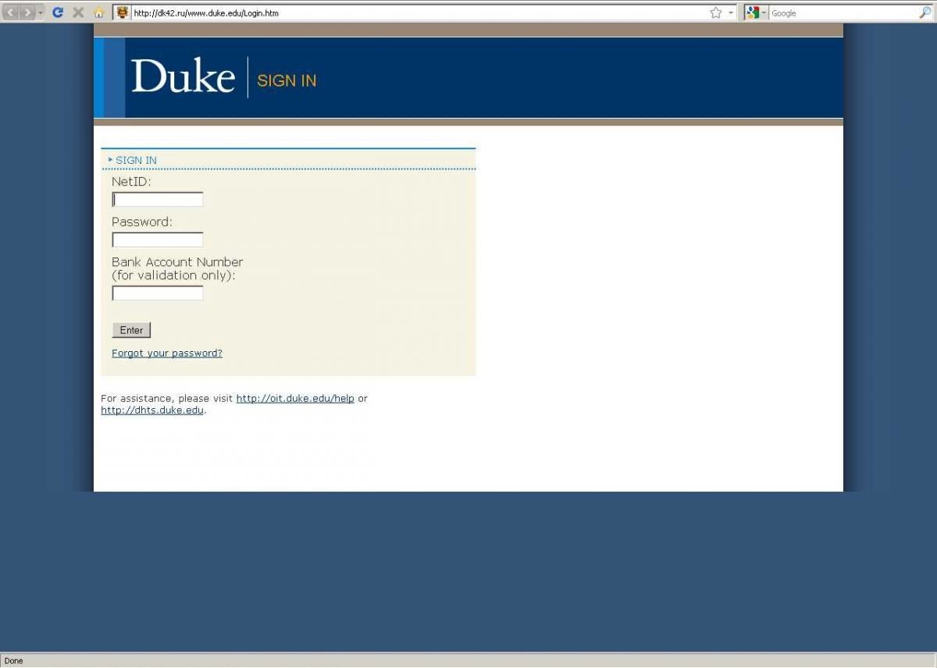
The message went to 617 people.
9 people fell for the message

Slide 14

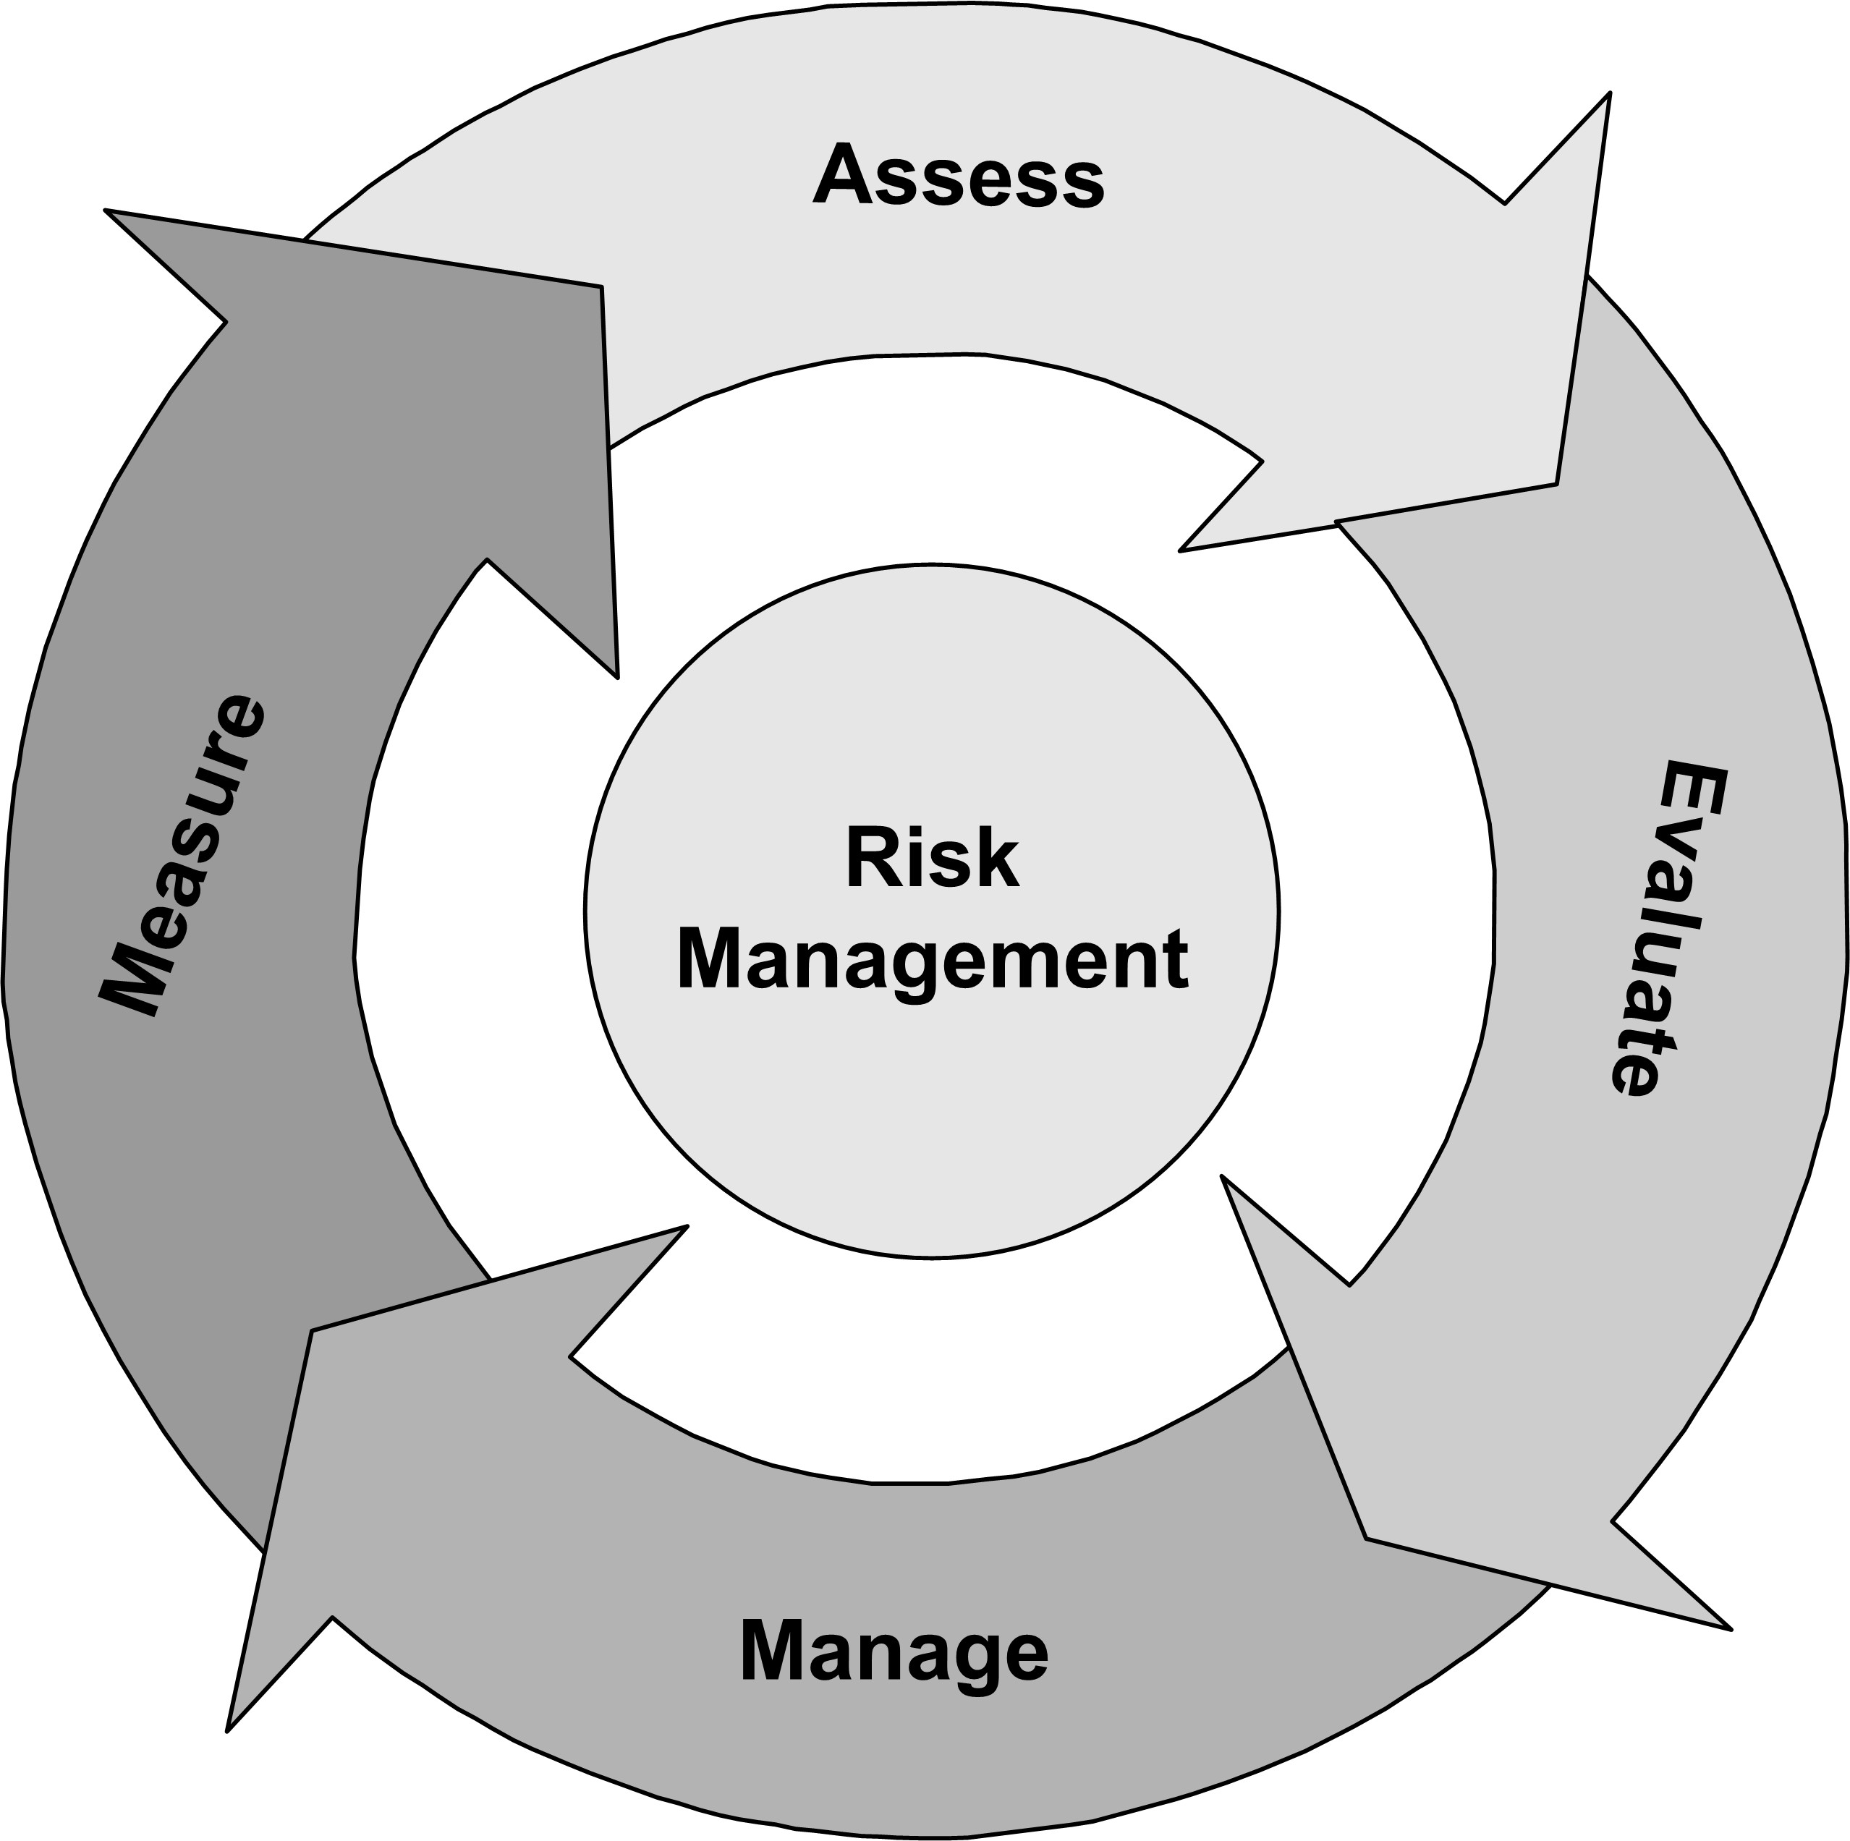
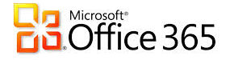

Phishing Attack
Internet
Fake NetID
Duke Security Controls
Protective Measures:
Roll-out of MFA
Auto-lock compromised accounts
Any compromised account is required to enroll in MFA
User Awareness & Training
Free Software made available (Endpoint Protection, Lastpass, MFA)
Detective Measures:
Monitor user logins from multiple locations
Monitor multiple logins from a single external source
Seed Phishing site with fake UserID, monitor for intel
Doctors, Researchers,
Staff, Guests
Protected
Network
Notes:
At Duke, we have the usual stack of protective and detective controls such as antivirus, data loss prevention, IPS, IDS, vulnerability scanners, firewalls, etc. We are also in the process of deploying Sourcefire IPS units for the Internet border, and Sourcefire IDS units for the core network. We also have Cisco Managed Threat Detection to augment our internal IR. The addition of a commercial threat intelligence feed and inline malware inspection much needed additions to our toolbox.
In our experience we see the same users compromised repeatedly, mainly due to unsafe practices: such as storing passwords in cleartext on a personal device or in the cloud.
Measures taken for this Case:
Step 1 – Use Splunk to identify recipients
Step 2 – Seed site with fake NetID (follow breadcrumbs)
Step 3 – Block URL
Step 4 – Monitor Splunk for NetID compromise
Step 5 – Lock accounts and notify
Step 6 – Protect with multifactor and SAP security
Security Applications are made available for work and home use, but are optional. However, once a user account has been compromised, the user is required to use MFA to access the network. Issue is that not all applications and servers are configured to for MFA.

Slide 15
Weighing the Costs
Before the Incident
After the Incident
IR Tools
Trained, experienced staff
Regular Risk Assessment and Audits
Third-party Consultants and Investigative Teams
Technical & Awareness Training
Recovery/Replacement of damaged assets
Notes:
Some costs will lower the overall costs of an incident: in-house IR team, employee training, encryption requirements, insurance.
These represent the direct costs related to the assets lost or compromised in a Security Incident as well as the cost of responding to and recovering from the incident.
Examples:
Service desk activities, communications, special investigative activities, remediation, legal expenditures, identity protection services and regulatory interventions.
Data breach costs associated with detection and escalation typically include forensic and investigative activities, assessment and audit services, crisis team management and communications to executive management and board of directors.

Slide 16
Indirect Costs
Intangible Costs
Tangible Costs
Damage to Corporate Brand or reputation
Loss of future customers/clients/investors
Regulatory fines
Loss of Revenue (Sales, productivity, etc.)
Legal fees
Identity Protection Services
Notes:
Assessing Incident Damage and Cost
When determining the damage to your organization, you should consider both direct and indirect costs. Incident damage and costs will be important evidence needed if you decide to pursue any legal action. These could include:
Costs due to the loss reputation due to the release of IP or sensitive information.
Legal costs.
Labor costs to analyze the breaches, reinstall software, and recover data.
Costs relating to system downtime (for example, lost employee productivity, lost sales, replacement of hardware, software, and other property).
Costs relating to repairing and possibly updating damaged or ineffective physical security measures (locks, walls, cages, and so on).
Other consequential damages such as loss of reputation or customer trust.

Slide 17
Security Focus Areas
Network Security
System Security
End User & Account Protection
Logging & Analysis
Risk & Governance

Slide 18
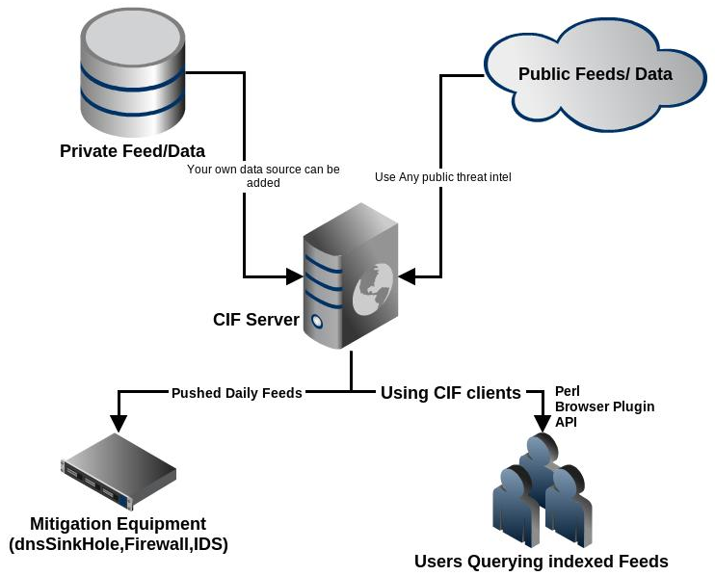
Security Defenses and Techniques: Network Security
NGFW
VRF Technology
IPS/IDS utilizing CIF
Managed Security Services & Threat Defense
Notes:
Firewalls and IDS/IPS should be familiar. In the recent past, many of you may have become familiar with the term VRF, which means virtual routing and forwarding VRF technology allows for multiple instances of a routing table to exist in a layer 3 devices (router/switch) and work simultaneously, enabling the isolation of traffic, but it is done with more bandwidth efficiency than a VLAN, which is a security and efficiency win.
Managed Security allows 24x7 monitoring of threats, including zero day attacks, advanced persistent threats, and known intrusions. Duke Medicine has made a significant investment in ensuring that our monitoring activities are being performed 24x7/365. Global intelligence and information is leveraged to determine and alert on security events.
CIF is where we tie together our detection and response pieces. CIF provides the ability to centrally store “observations” about bad activity.
Observations/Intel are collected from public lists (Dragon Research Group, malwaredomains.com, etc) automatically, and organizations can also add their own observations (automatically or manually).
Periodically, CIF uses observations to generate “feeds” based on specified criteria.
These feeds can be consumed by devices, or queried by analysts.

Slide 19

Security Defenses and Techniques: Systems Security
Automated Patching (IEM)
Data Loss Prevention (DLP)
Mobile Device Management
Web Application Security
Reduced Administrative Rights
Notes:
Inconsistent application security measures, such as patching, is a known risk, and there are solutions to help to ensure a basic level of security.
Consumers are choosing devices, and accessing internal resources from the devices. Additionally in the Healthcare industry, there are a number of health apps that are centered around mobile devices – ie., Apple Health App. As our environment changes, solutions must evolve to ensure visibility and protect patient data.
There has been a lot of press about the POS breaches, such as Target and Home Depot. But it’s the web application attacks that are increasing. Annually, Verizon issues a data breach report that describes attacks based on their customer base. In the 2014 report, web application attacks are the most frequent type of attack. In fact, they represent 35% of all attacks, and that number has increased over the prior year. The POS attacks are only 14%, and according to the Verizon report, they are not increasing. Organizations should be placing a larger emphasis on web application security and scanning.
Generally accessible 24/7 from almost anywhere, insecure web applications provide easy access to backend databases and also allow hackers to perform illegal activities using the compromised site. Tools such as Burpsuite, Metasploit, Nessus, and a series of open source testing tools can be used to test the massive landscape of web applications.
Shared and Privileged accounts: In 2009, Beyond Trust, studied MS vulnerabilities and determined that 92% of the critical vulnerabilities could have been mitigated by least privilege. The importance of limiting administrative rights on systems, MS, Linux, MAC – all systems– is equally important today, and it is crucial to protecting Duke information assets from attack. On the Duke Medicine side, our risk assessment this year is focused on administrative rights, as it was in the prior year, and we expect new programs to develop from those assessments.

Slide 20
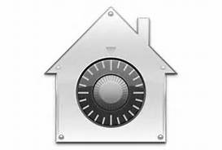


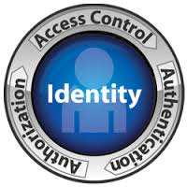

Security Defenses and Techniques: End User and Account Protection
Whole Disk Encryption
Spam Filtering
Endpoint Protection – it’s not just Anti-virus anymore
Identity and Access Mgt (IAM)
Secure Sign On Service
Multifactor authentication (MFA)
Password Escrow
Notes:
With a growing number of devices and applications, it is harder to manage privileges. Too many identities and credentials increases the attack surface, so developing a streamlined way to manage identity and access across enterprise applications and outside the organizational network is essential.

Slide 21
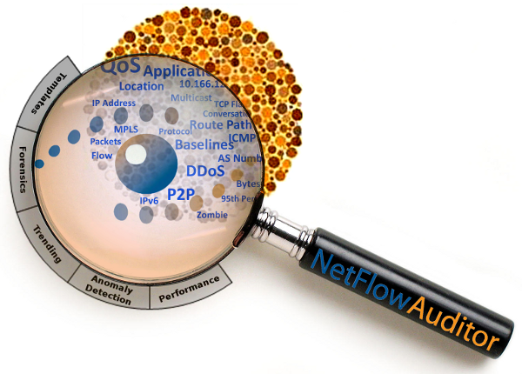
Security Defenses and Techniques: The Incident Response Toolbag
Security Information & Event Management (SIEM)
Threat & Intel Feeds
NetFlow Analysis
Log Correlation and Analysis
Forensics
Open Source Toolkits
Notes:
Servers, networking devices, applications, etc. create large volumes of log data, that can’t be easily analyzed. A centralized logging application such as Spunk provides a method of searching and analyzing log data, and reducing the time it takes to investigate an incident.

Slide 22



Security Defenses and Techniques: Risk & Governance
Risk assessments, vulnerability scanning & penetration testing
Compliance audits
Policy updates
Awareness, training and outreach
Notes:
Security, like any business function, is a combination of technology, people and process. We can have firewalls and AV, but without the people and process, the security program is ineffective. We have discussed a lot of technology in this presentation, so this last slide is dedicated to the process and people aspects of security.
Security starts with a risk assessment. Every major compliance regulation requires it. Because technology and the landscape changes quickly, so do the risks. All of the tools and processes discussed today either help manage risk. Analyzing those risks by identifying threats and vulnerabilities, and applying cost/beneficial solutions to bring risk to an acceptable level describes the risk assessment process, which is continuous.
Policy and standards drive application of controls and are set the requirements for technology selections.
Awareness, training and outreach – The focus of awareness is building a consciousness of security threats and how a user or IT professional can do their part to protect privacy, intellectual property and sensitive data. Behavior adjustments will often need to occur, as it is becoming easier to inadvertently put SEI in a place (mobile device, cloud, etc.) where it should not be, so secure behaviors must be enforced. Measurement is the most difficult pieceparticularly in determining how to measuring results.

